Slide 1
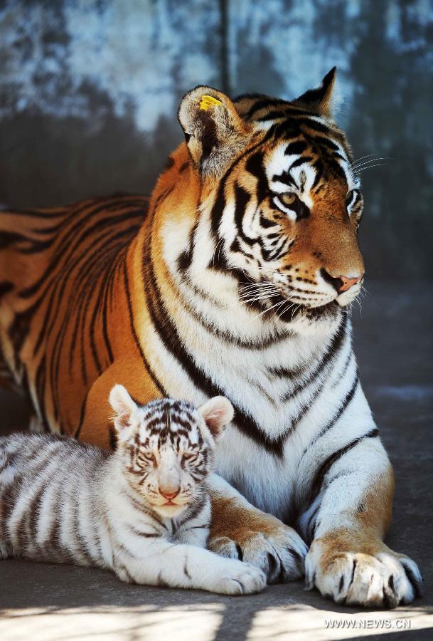
RNA & Protein Synthesis
Chapter 13
(p. 360-376)

Slide 2
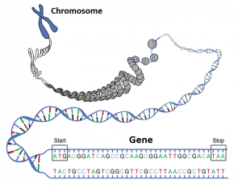
What is a Gene?
Notes:
DNA contains sequences of nitrogenous bases that we call genes.
Each gene codes for one polypeptide (primary structure of a protein).
The unique sequence of the gene is what determines the unique order in which amino acids are bonded together.

Slide 3
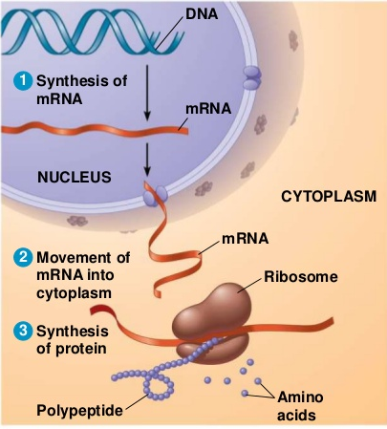
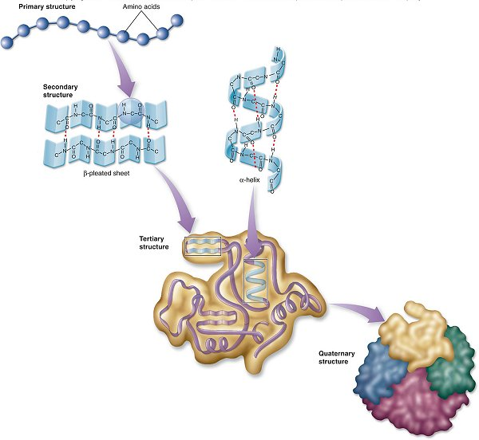
To Make a Protein…
Notes:
DNA cannot leave the nucleus, but contains the instructions on how to build polypeptides.
Ribosomes build polypeptides, but cannot travel into the nucleus.
Messenger RNA (mRNA) is like a disposable copy of the master instructions. It carries the genetic “message” from DNA to the ribosome.
The process of making mRNA from DNA is called transcription.
The process of building the polypeptide (carried out by the ribosome) is called translation.

Slide 4
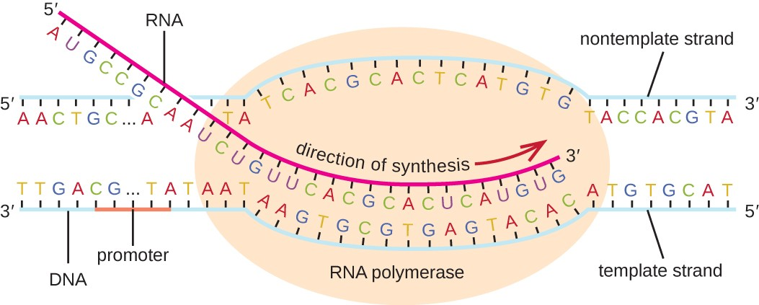
Step 1: Transcription
Notes:
DNA cannot leave the nucleus, but contains the instructions on how to build polypeptides.
Ribosomes build polypeptides, but cannot travel into the nucleus.
Messenger RNA (mRNA) is like a disposable copy of the master instructions. It carries the genetic “message” from DNA to the ribosome.
The process of making mRNA from DNA is called transcription.
The process of building the polypeptide (carried out by the ribosome) is called translation.

Slide 5
Step 2: RNA Editing
Notes:
DNA cannot leave the nucleus, but contains the instructions on how to build polypeptides.
Ribosomes build polypeptides, but cannot travel into the nucleus.
Messenger RNA (mRNA) is like a disposable copy of the master instructions. It carries the genetic “message” from DNA to the ribosome.
The process of making mRNA from DNA is called transcription.
The process of building the polypeptide (carried out by the ribosome) is called translation.

Slide 6
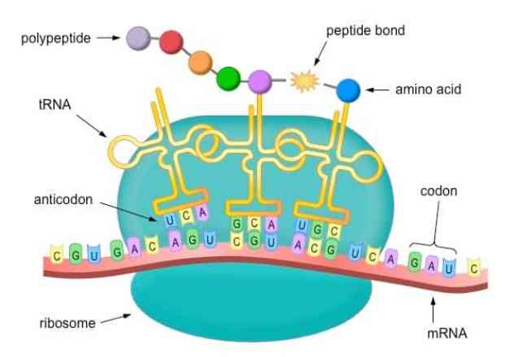
Step 3: Translation
Notes:
DNA cannot leave the nucleus, but contains the instructions on how to build polypeptides.
Ribosomes build polypeptides, but cannot travel into the nucleus.
Messenger RNA (mRNA) is like a disposable copy of the master instructions. It carries the genetic “message” from DNA to the ribosome.
The process of making mRNA from DNA is called transcription.
The process of building the polypeptide (carried out by the ribosome) is called translation.

Slide 7
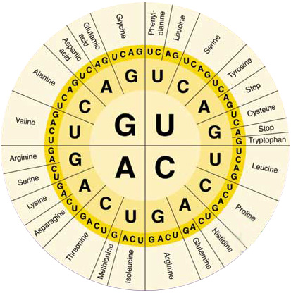
Codon Chart
Notes:
Use this chart any time you are asked to translate a sequence of mRNA into a polypeptide.
Always start from the middle of the chart and work your way toward the outside to identify the amino acid.
Stop codons do not specify an amino acid, they simply tell the ribosome that it has reached the end of the strand of mRNA.

Slide 8
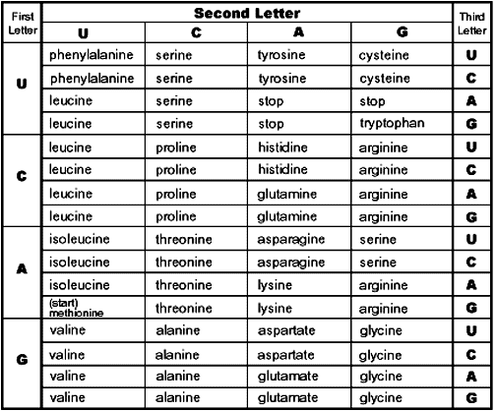
Codon Chart

Slide 9
Transcription/Translation Practice
T A C G G G C T A G T T T C A C C C G T C A T T

